Slide 1
Big Data: Energy Disaggregation
CMSC 123 Project Proposal
Terrance Liu, Anna Kim, Joan Wang

Slide 2
The Reference Energy Disaggregation Data (REDD) Set
Contains detailed power usage information from 10 homes
Total electricity signal for each home
Up to 24 circuits, labeled by appliance type
Disaggregation - separate an aggregate electricity signal into its component appliance contributions
Compiled for research purposes by J. Zico Kolter and Matthew J. Johnson, researchers at MIT

Slide 3
REDD (cont.)
10 monitored homes in Boston area
119 days of data
Over a terabyte of raw data
Waiting for reply to access/verify dataset size

Slide 4
REDD (cont.)
Low Frequency Dataset
~1HZ readings for entire home and circuits
Logged every 1 sec for mains and 3 sec for circuits
Format: device category label, time, wattage
High Frequency Dataset
group current/volume waveforms
Format: time, cycle count, value of waveform (amps or volts)

Slide 5
Research Questions
What’s the best method to disaggregate the energy information from REDD? Can we beat the 50% accuracy reached by REDD?
Studies show that having the disaggregated data helps households maximize energy conservation
What does our disaggregation model tell us about energy use in US households?

Slide 6
Exploration Method
Research literature on energy disaggregation
Replicate modelling method used in REDD paper
Test algorithms not used in REDD by using 5 houses for training data, 5 houses for testing
Graphically represent accuracy of different methods
Accuracy based on true categories provided by REDD

Slide 7
Models used by REDD
Factorial Hidden Markov Model
Used in REDD paper, reached 50% accuracy
Given an aggregate power recorded, infer the probability of the power used by each device
Simple mean
baseline performance
reached ~25% accuracy

Slide 8
Possible Algorithms
K-nearest neighbors (plurality)
Clustering
k-means
parametric Bayesian clustering
Sparse coding algorithm

Slide 9
Ideal Result of First Prototype
For our first model, the FHMM
hope for ~50% accuracy
Additional models
hope to reach at least 25% accuracy (Simple mean)

Slide 10
Final Results
Graphical representation of disaggregated energy models using our algorithms
Comparison of accuracy of different algorithms
Relationships between energy usage and appliance
Peak times of energy use
Implications for energy sustainability

Slide 11
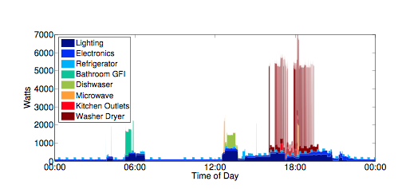
Final Results (cont.)
Source: http://redd.csail.mit.edu/kolter-kddsust11.pdf

Slide 12
What we hope to learn?
How to implement different algorithms
Measure and compare the performances of the algorithms

Slide 13
Timeline
April 15 – 23: Become familiar with REDD and write functions to replicate REDD results using FHMM
April 24 – 30: Develop a prototype using a different algorithm that returns the disaggregated energy results for a household with at least 20% accuracy
May 1 – 14: Implement techniques onto full dataset
May 15 – 21: Represent data in visual/graphical way
May 22 – June 3: Debug, finalize project

Slide 14
Additional Thoughts
Concerns
Contacting the dataset owner to gain access
Appropriate data size?
Do something similar with different data?

Slide 15
Questions?
(Ideas?)

